Slide 1

Journey with Data Intro to iSpace

Slide 2
Contents
Introduction
Changing your mailbox setting
Modify your account info
Modify your password
Uploading a sample exercise or assignment
Create a folder
Zip the folder
Submit the zip file

Slide 3
A. Introduction
iSpace is a powerful e-learning platform which is used for most courses at UIC. The features of iSpace include lecture notes uploading and downloading, assignment submitting, online quizzes, etc.
In this lab we will introduce some basic features of iSpace so you will know how to use this platform properly throughout your studies at UIC.

Slide 4
B. Changing your mailbox setting
Modify your account info
Modify your password

Slide 5
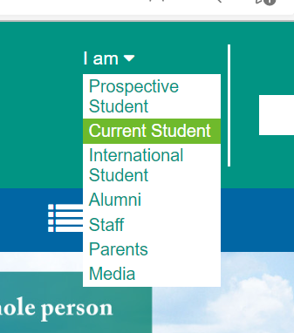
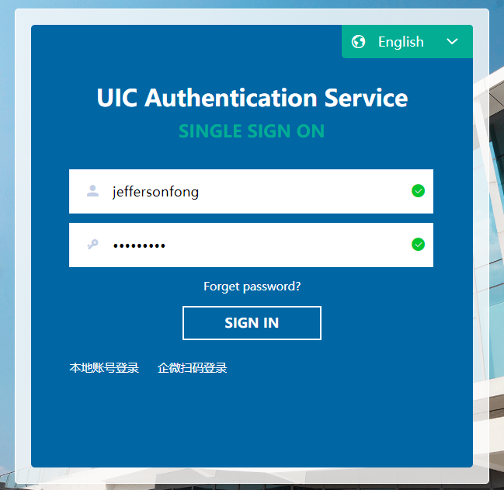
B. Changing your mailbox setting
Login https://uic.edu.cn/
Your user name is your student ID number (with the first digit of your student ID number replaced by a letter)
Your default password is your resident ID number.

Slide 6
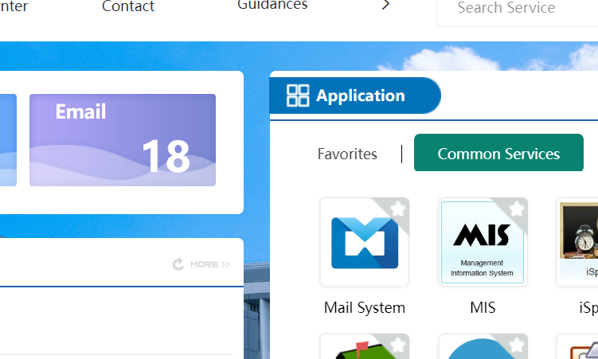
B. Changing Your Mailbox Setting
To see or send emails, click Email.
UIC sends official notices by email.
To change your mailbox setting, click Mail System.

Slide 7
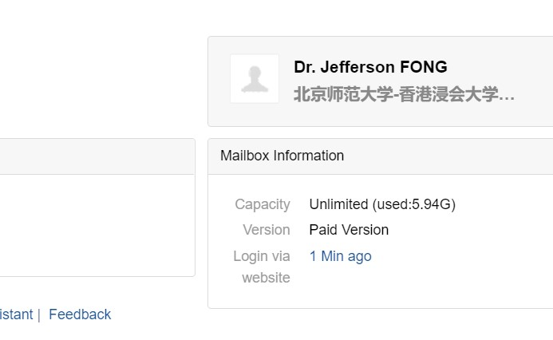
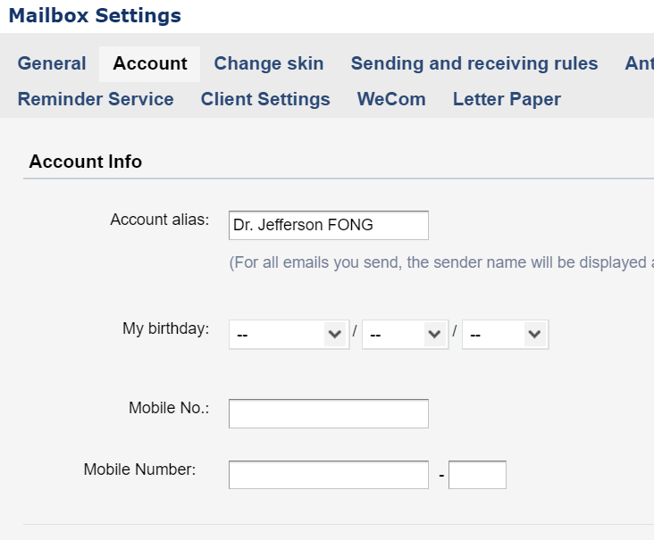
B1. Modify account info
Click on your name. Your Mailbox Settings should appear.
Fill in the missing Account info.
Upload a photo.

Slide 8
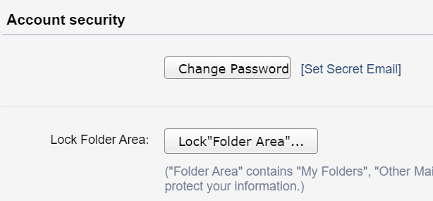
B2. Modify Your password
To change your password, scroll down to the Account security section and click Change Password.
In the change Password window, enter your old and new password.
Don’t change your password unless you really want to.
E.g. you should change password if you are still using the default password.
Remember your new password if you do change your password.

Slide 9
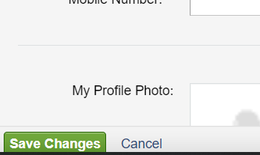
B. Changing mailbox setting
At the bottom of the screen, click Save Changes if you want to keep your changes.
Click Cancel if you want to loose your changes.

Slide 10
C. Upload a sample exercise or assignment C0. iSpace basics C1. Create a folder to hold the exercise or assignment C2. Zip the folder C3. Upload the zip file

Slide 11
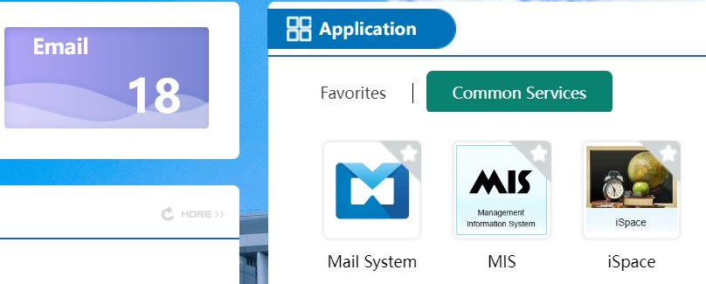
C0. iSpace Basics
Logging into iSpace
Either directly (https://ispace.uic.edu.cn/ )
Use the same account and password as your UIC portal in Part B.
Or click the iSpace icon in the Application section in the eMail screen.

Slide 12
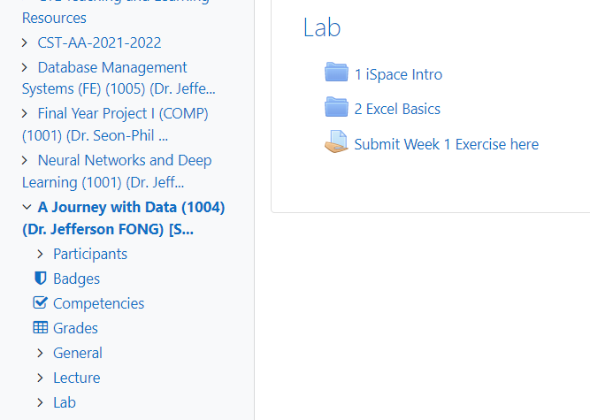
C0. iSpace Basics
In iSpace left hand side (LHS), navigate to the course A Journey with Data.
The course material appears at the right hand side (RHS)

Slide 13
C. Upload a sample exercise or assignment
Every course in UIC can use iSpace to collect assignments. This section shows you how to upload an exercise or assignment.
C1. Create a folder to hold the exercise or assignment files.
C2. Zip the folder.
C3. Upload the ZIP folder to iSpace.

Slide 14
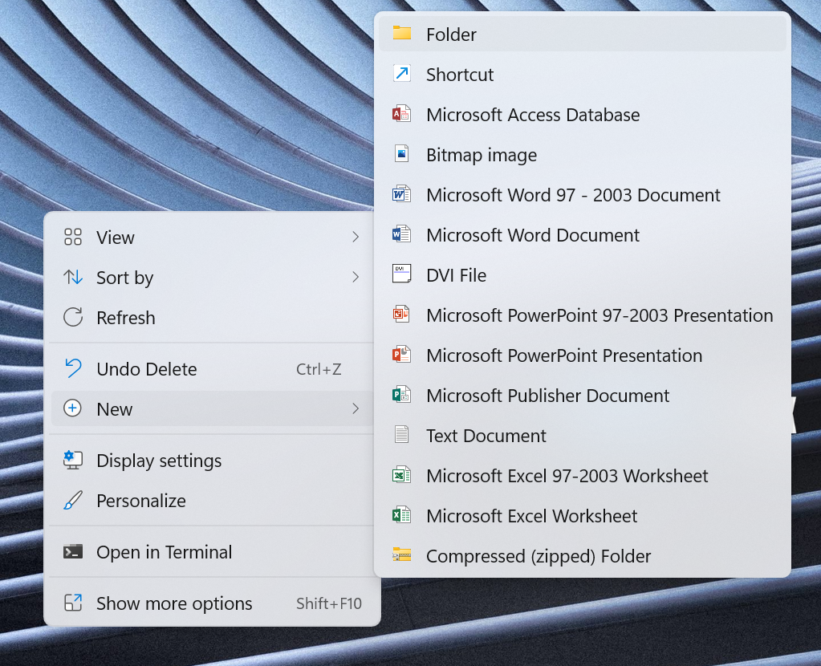
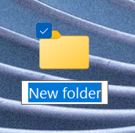
C1. Creating a folder
Create a folder
Right click on your Desktop > New > Folder
A new folder appears.

Slide 15
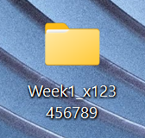
C1. Creating a folder
Change the name of the new folder to “Week1_x123456789”, with x123456789 replaced by your student ID.
Create 1 or 2 files using NotePad or Word. Pretend those files are your lab exercises.
Save the dummy files in the folder you’ve just created.
When you submit the real lab exercise later, you will replace these dummy files.

Slide 16
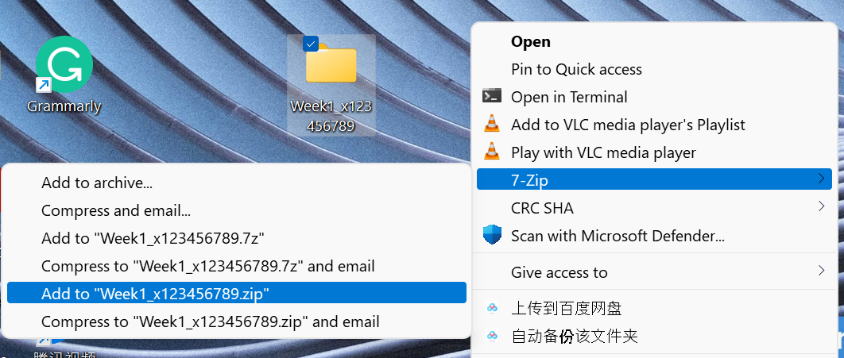
C2. ZIP the folder
Right click on the folder > 7-Zip > Add to
“Week1_x123456789.zip”
Be sure to choose .zip file and not .7z file.

Slide 17
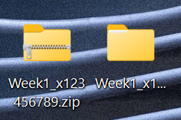
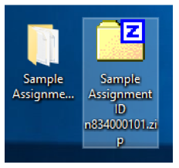
C2. ZIP the folder
A zip file is created. Depending on the version, the zip file can look like one of the following.
You can submit the zip file to iSpace

Slide 18
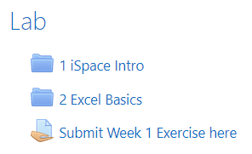
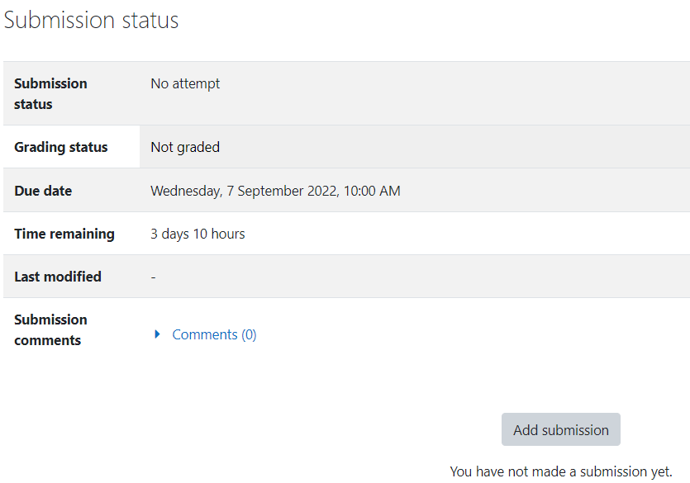
C3. Upload the zip file to iSpace
In iSpace for this class, click the link “Submit Week 1 Exercise here”.
Click “Add submission”

Slide 19
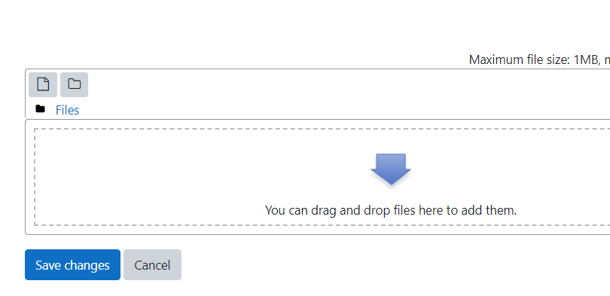
C3. Upload the zip file to iSpace
Drag (or copy and paste) the zip file into the target area.
Click “Save change”.
Notice the submission status is changed.
If you submit another zip file before the due date, only the last submission is saved; the previous submission is lost.

Slide 20
Submission
Submit a zip file containing dummy file(s) into the link “Submit Week 1 Exercise here”.
The submit file should be named “Week1_x123456789.zip”, with x123456789 replaced by your student ID.
After you create the .xlsx files from the Excel basic exercises, you can replace the dummy file with your .xlsx files and resubmit the zip folder to iSpace.

